Slide 1
Klipper Defaults
Default i2c_bus SDA=>PB6, SCL=>PB7
Default i2c1 SDA=>PB10, SCL=>PB11
Default SPI1 SCK=>PB13, MIS0=>PB14, MOSI=>PB15
Default SPI2 SCK=>PA5, MIS0=>PA6, MOSI=>PA7
Default SPI3 SCK=>PB3, MIS0=>PB4, MOSI=>PB5
Default USBD+=>PA12, USBD-=>PA11
Default Serial1 RX=>PA10, TX=>PA9
Default Serial2 RX=>PA3, TX=>PA2
Default Serial3 RX=>PD9, TX=>PD8
Default Serial4 RX=>PB11, TX=>PB10
Default ADC PA0, PA1, PA2, PA3, PA4, PA5, PA6, PA7, PB0, PB1, PC0, PC1, PC2, PC3, PC4, PC5, PF6, PF7, PF8, PF9, PF10, PF3, PF4, PF5

Slide 2
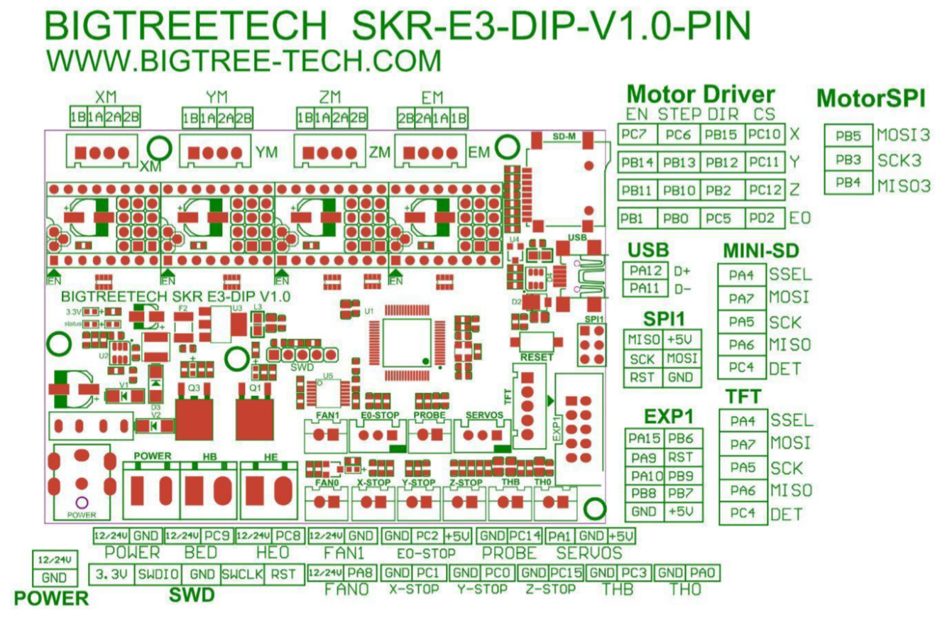

Slide 3
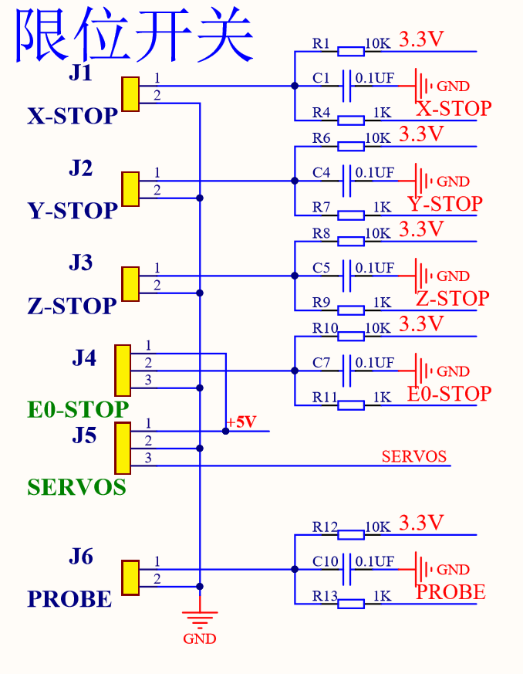
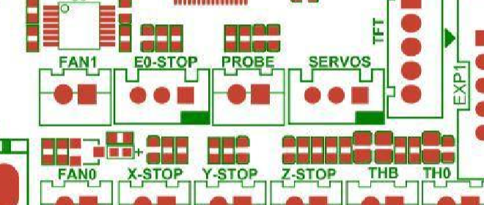
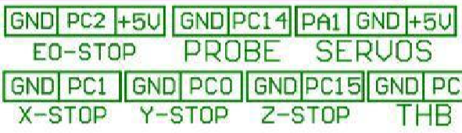
X_STOP | PC1 | I/O
 |  | I | ADC123_IN11
Y_STOP | PC0 | I/O
 |  | I | ADC123_IN10
Z_STOP | PC15 | I/O
 |  | O | OSC32_OUT
E0_STOP | PC2 | I/O
 |  | I | ADC123_IN12
PROBE | PC14 | I/O
 |  | I | OSC32_IN
SERVOS | PA1 | I/O
 |  | I/O | USART2_RTS/ ADC123_IN1/ TIM5_CH2/TIM2_CH2

Slide 4
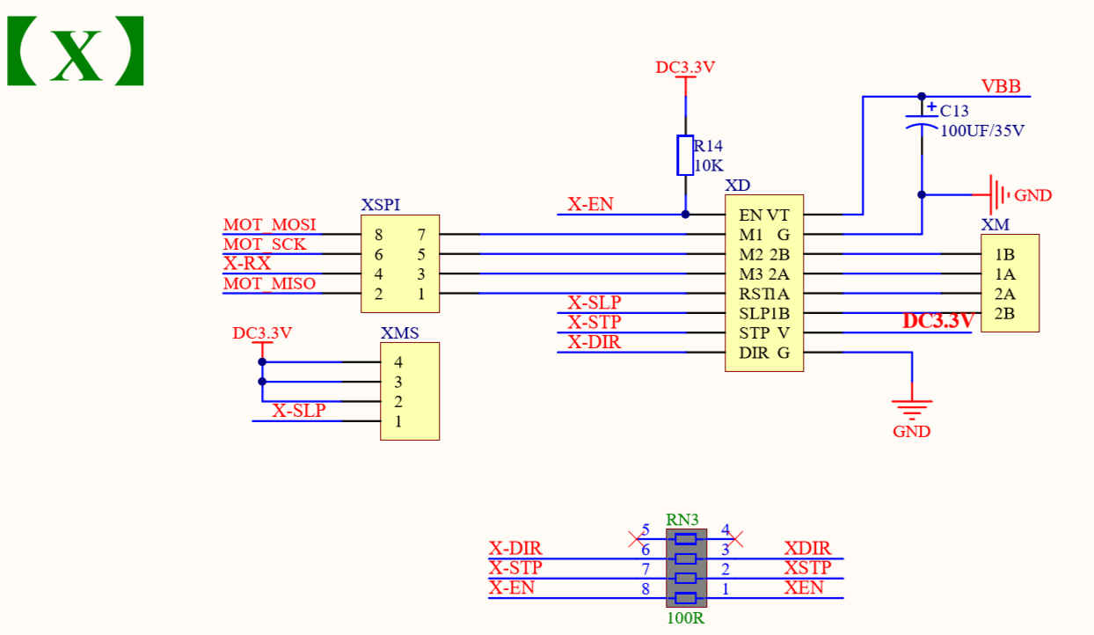
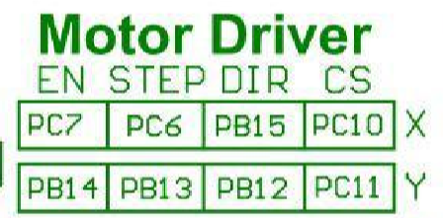
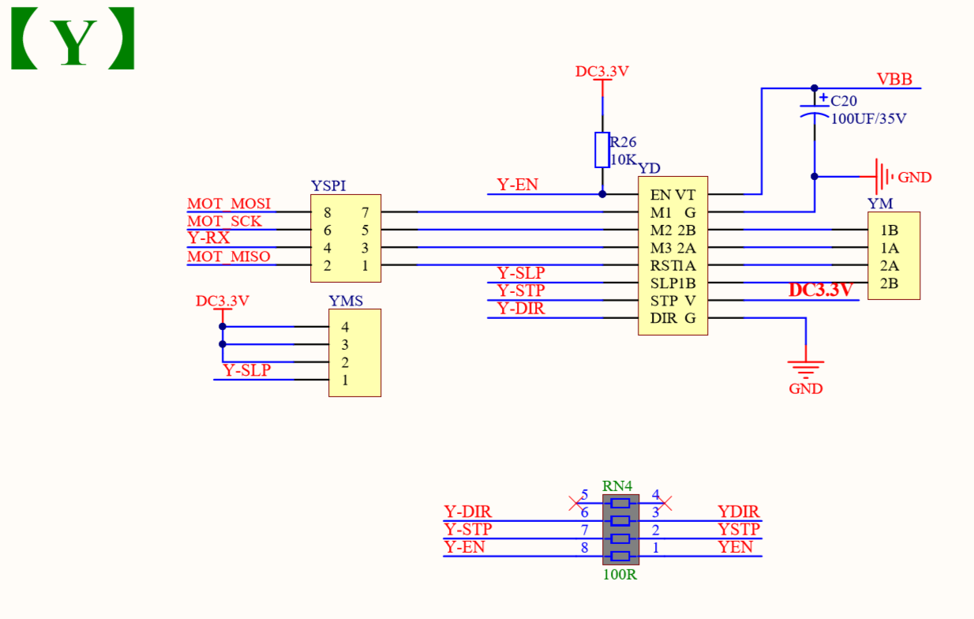
X_EN | PC7 | I/O
 |  | O | I2S3_MCK/ TIM8_CH2/SDIO_D7
X_STEP | PC6 | I/O
 |  | O | I2S2_MCK/ TIM8_CH1/SDIO_D6
X_DIR | PB15 | I/O
 |  | I | SPI2_MOSI/I2S2_SD TIM1_CH3N
 |  | I
 |  | O
Y_EN | PB14 | I/O
 |  | O | SPI2_MISO/TIM1_CH2N USART3_RTS
 |  | O
Y_STEP | PB13 | I/O
 |  | I | SPI2_SCK/I2S2_CK USART3_CTS(9)/ TIM1_CH1N
 |  | I/O
Y_DIR | PB12 | I/O
 |  | O | SPI2_NSS/I2S2_WS/ I2C2_SMBA/ USART3_CK/ TIM1_BKIN
 |  | I/O

Slide 5
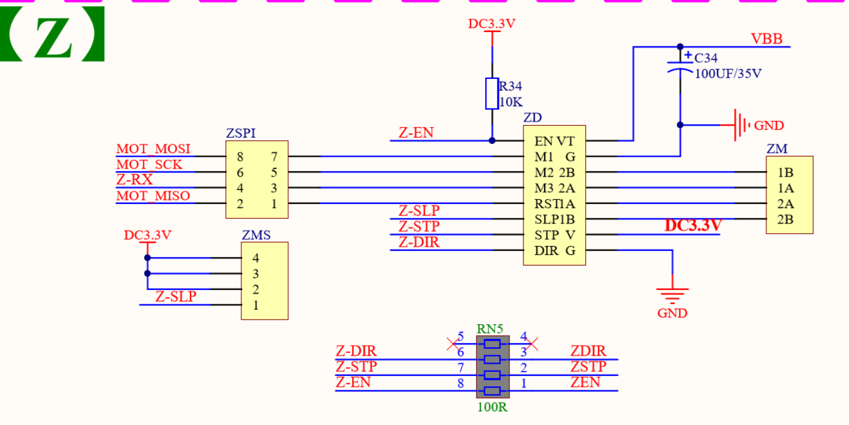
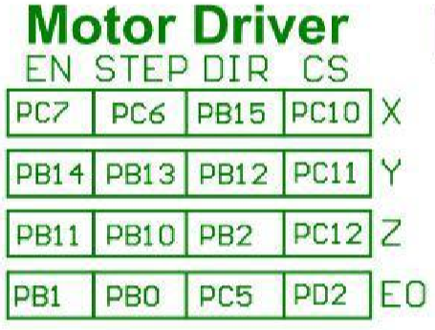
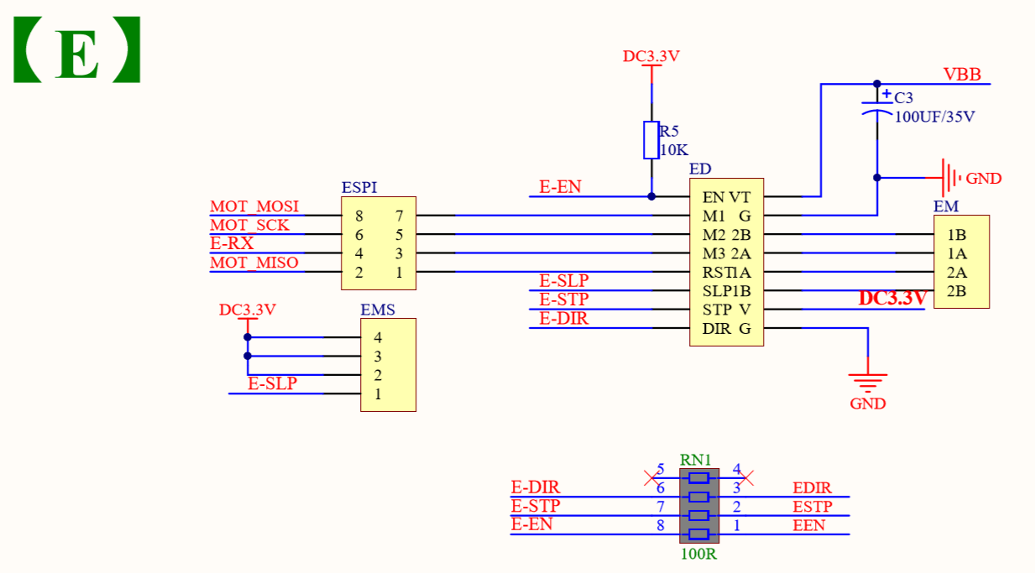
Z_EN | PB11 | I/O
 |  | I | I2C2_SDA/USART3_RX
 |  | I
Z_STEP | PB10 | I/O
 |  | O | I2C2_SCL/USART3_TX
 |  | O
Z_DIR | PB2 | I/O
 |  | I | PB2/BOOT1
 |  | I/O
E0_EN | PB1 | I/O
 |  | I | ADC12_IN9/TIM3_CH4/ TIM8_CH3N
 |  | I/O
E0_STEP | PB0 | I/O
 |  | I | ADC12_IN8/TIM3_CH3 TIM8_CH2N
 |  | I/O
E0_DIR | PC5 | I/O
 |  | I | ADC12_IN15
 |  | I/O
 |  | O

Slide 6
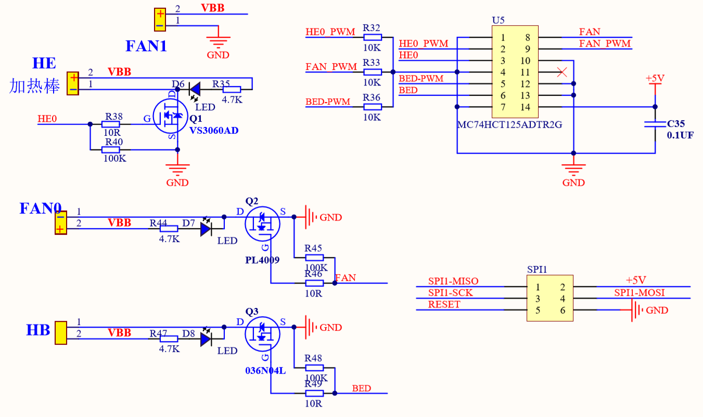

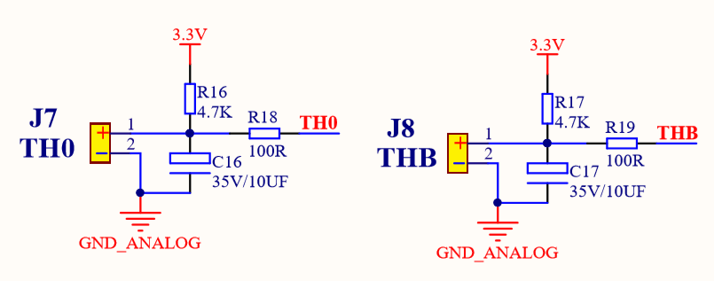
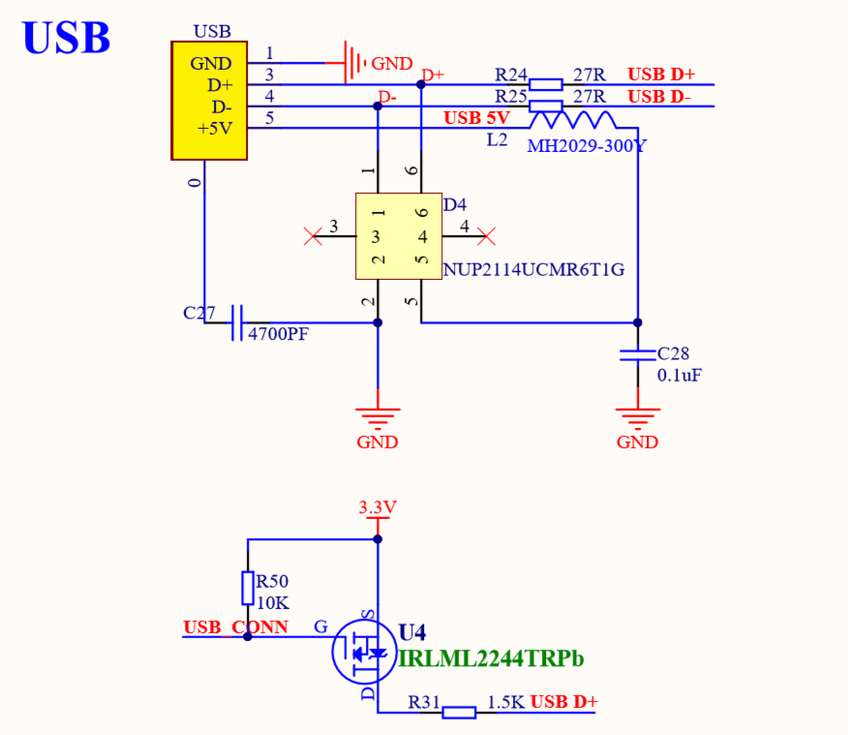

HE | PC8 | I/O
 |  | O | TIM8_CH3/SDIO_D0
 |  | I/O | TIM3_CH3
 |  | O
FAN0 | PA8 | I/O
 |  | O | USART1_CK/ TIM1_CH1/MCO
 |  | I
 |  | I/O
HB | PC9 | I/O
 |  | I | TIM8_CH4/SDIO_D1
 |  | O | TIM3_CH4
 |  | I/O
TH0 | PA0 | I/O
 |  | I | WKUP/USART2_CTS/ ADC123_IN0 TIM2_CH1_ETR TIM5_CH1/TIM8_ETR
 |  | I/O
 |  | O
THB | PC3 | I/O | ADC123_IN13
 |  | I
 |  | I/O
 |  | I
USB D+ | PA12
 |  |  | USART1_RTS/USBDP/ CAN_TX/TIM1_ETR

Slide 7
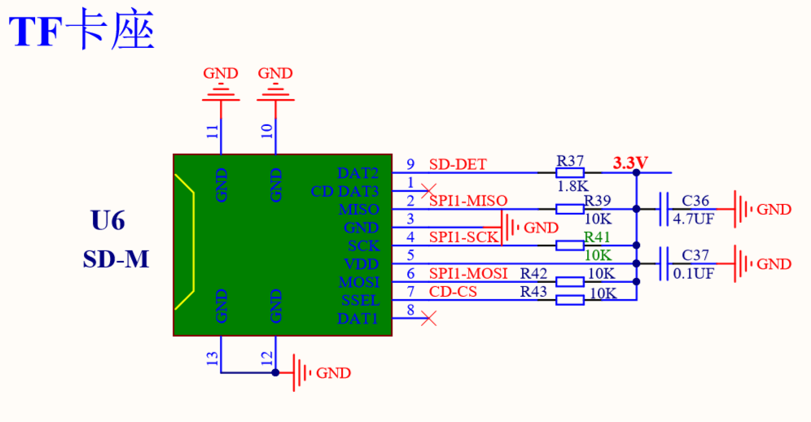
USB D- | PA11 | I/O
 |  |  | USART1_CTS/USBDM /CAN_RX/TIM1_CH4(9)
SD_DET (NO_USE) | PC4 | I/O
 |  | I/O
 |  | I/O
SD_MISO / SPI1-MISO | PA6 | I/O
 |  | I/O | SPI1_MISO/ TIM8_BKIN/ADC12_IN6 /TIM3_CH1
 |  | I/O
 |  | O
SD_SCK / SPI1-SCK | PA5 | I/O
 |  | I/O | SPI1_SCK/DAC_OUT2/ADC12_IN5
 |  | I/O
 |  | O
SD_MOSI / SPI1-MOSI | PA7 | I/O
 |  | I/O | SPI1_MOSI/ TIM8_CH1N/ADC12_IN7/ TIM3_CH2
 |  | I/O
 |  | O
SD_SSEL (ONBOARD_SD_CS) | PA4 | I/O
 |  | I/O | SPI1_NSS/ USART2_CK/DAC_OUT1/ADC12_IN4
 |  | I/O
 |  | O

Slide 8
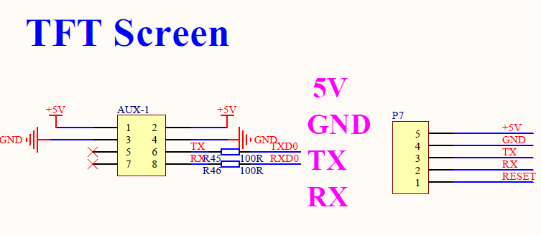
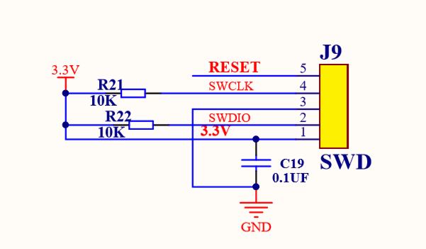
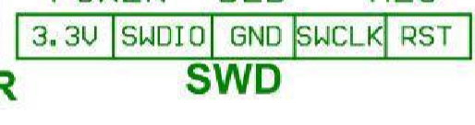
TX0 | PA2 | I/O
 |  | O | USART2_TX/TIM5_CH3 ADC123_IN2/ TIM2_CH3
 |  | I
RX0 | PA3 | I/O
 |  | I | USART2_RX/TIM5_CH4/ ADC123_IN3/TIM2_CH4
 |  | I
RESET | NRST | I/O
SWCLK | PA14 | I/O | JTCK-SWCLK
SWIO | PA13 | I/O | JTMS-SWDIO

Slide 9
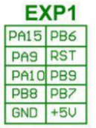
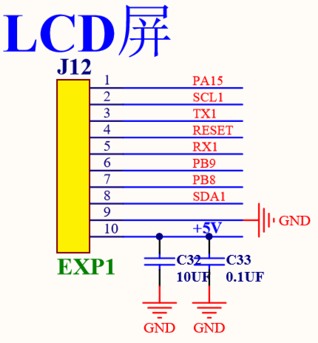
LCD7 / NO-USE / D_MOSI (LCD_ENABLE) | PB7 | I/O
 |  | I | I2C1_SDA / FSMC_NADV / TIM4_CH2
 |  | O | USART1_RX
 |  | I/O
LCD5 / NO-USE / D_SCK (LCD_D4) | PB9 | I/O
 |  | O | TIM4_CH4/SDIO_D5
 |  | O | I2C1_SDA / CAN_TX
 |  | I/O
LCDRS / D_CS (LCD_RS) / RESET | RST | I/O
 |  | O
 |  | O
 |  | I
BTN_ENC / BTN_CLICK (BTN_ENC) / BTN_CLICK (BTN_ENC) | PB6 | I/O
 |  | I/O | I2C1_SCL/ TIM4_CH1
 |  | I/O | USART1_TX
LCD6 / NO_USE / D_CS (LCD_RS) | PB8 | I/O
 |  | O | TIM4_CH3/SDIO_D4
 |  | I | I2C1_SCL/ CAN_RX
 |  | O
LCD4 / D_SCK (LCD_D4) / BTN_EN2 | PA10 | I/O
 |  | I | USART1_RX/ TIM1_CH3
 |  | O
 |  | I/O
EXP1 / EXP1 Serial Display / EXP3 Serial Display No SD Card Support
EXP1 supports Creality stock display without SD card reader and single cable on EXP3
VCC / EXP1_10 | GND / EXP1_9
EXT-SDA / D-MOSI / PB7 / EXP1_8 | EXT-A3 / D-CS / PB8 / EXP1_7
EXT-A1 / D-SCK / PB9 / EXP1_6 | EXT-RX1 / BTN_EN1 / PA10 / EXP1_5
RESET / EXP1_4 | EXT-TX1 / BTN_EN2 / PA9 / EXP1_3
EXT-SCL / BTN_CLICK / PB6 / EXP1_2 | EXT-A4 / BEEPER / PA15 / EXP1_1
CR-10 / Ender 3 Stock Display / EXP3

Slide 10
LCDE / D_MOSI (LCD_ENABLE) / BTN_EN1 | PA9 | I/O
 |  | O | USART1_TX/ TIM1_CH2
 |  | O
 |  | I
BEEPER / BEEPER / BEEPER | PA15 | I/O
 |  | I | SPI3_NSS/ I2S3_WS
 |  | I | TIM2_CH1_ETR/PA15 / SPI1_NSS
VCC / EXP1_10 | GND / EXP1_9
EXT-SDA / D-MOSI / PB7 / EXP1_8 | EXT-A3 / D-CS / PB8 / EXP1_7
EXT-A1 / D-SCK / PB9 / EXP1_6 | EXT-RX1 / BTN_EN1 / PA10 / EXP1_5
RESET / EXP1_4 | EXT-TX1 / BTN_EN2 / PA9 / EXP1_3
EXT-SCL / BTN_CLICK / PB6 / EXP1_2 | EXT-A4 / BEEPER / PA15 / EXP1_1
Generic EXP1
VCC / EXP1_10 | GND / EXP1_9
EXT-SDA / D-MOSI / PB7 / EXP1_8 | EXT-A3 / D-CS / PB8 / EXP1_7
EXT-A1 / D-SCK / PB9 / EXP1_6 | EXT-RX1 / BTN_EN1 / PA10 / EXP1_5
RESET / EXP1_4 | EXT-TX1 / BTN_EN2 / PA9 / EXP1_3
EXT-SCL / BTN_CLICK / PB6 / EXP1_2 | EXT-A4 / BEEPER / PA15 / EXP1_1
Generic EXP2
VCC / EXP1_10 | GND / EXP1_9
EXT-SDA / D-MOSI / PB7 / EXP1_8 | EXT-A3 / D-CS / PB8 / EXP1_7
EXT-A1 / D-SCK / PB9 / EXP1_6 | EXT-RX1 / BTN_EN1 / PA10 / EXP1_5
RESET / EXP1_4 | EXT-TX1 / BTN_EN2 / PA9 / EXP1_3
EXT-SCL / BTN_CLICK / PB6 / EXP1_2 | EXT-A4 / BEEPER / PA15 / EXP1_1
CR-10 / Ender 3 Stock Display / EXP3

Slide 11
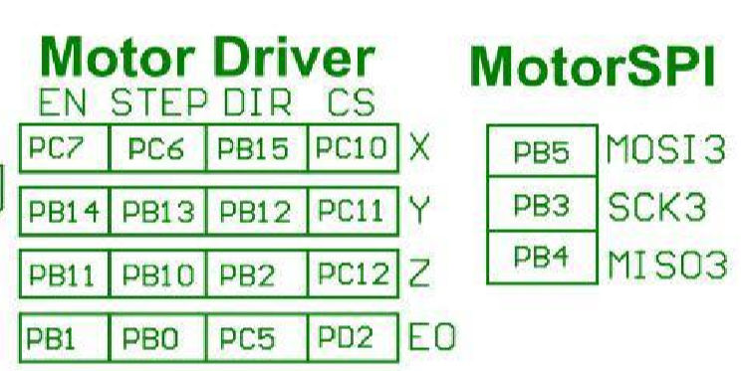
M_MISO3 | PB4 | I/O | NJTRST
 |  | I/O | SPI3_MISO
 |  | O | PB4 / TIM3_CH1 SPI1_MISO
 |  | I
M_MOSI3 | PB5 | I/O
 |  | O | I2C1_SMBA/ SPI3_MOSI I2S3_SD
 |  | O | TIM3_CH2 / SPI1_MOSI
 |  | O
M_SCK3 | PB3 | I/O
 |  | I/O | SPI3_SCK / I2S3_CK/
 |  | I | PB3/TRACESWO/TIM2_CH2 / SPI1_SCK
 |  | I
M_X_CS | PC10 | I/O
 |  | I/O | UART4_TX/SDIO_D2
 |  |  | USART3_TX
M_Y_CS | PC11 | I/O
 |  | I | UART4_RX/SDIO_D3
 |  |  | USART3_RX
M_Z_CS | PC12 | I/O
 |  | I | UART5_TX/SDIO_CK
 |  |  | USART3_CK

Slide 12
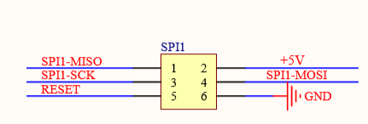
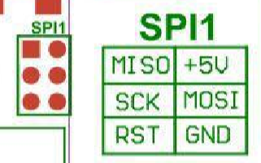
M_E0_CS | PD2 | I/O
 |  | I | TIM3_ETR/UART5_RX/ SDIO_CMD
SPI1_MISO | PA6 | I/O
 |  |  | SPI1_MISO/ TIM8_BKIN/ADC12_IN6 /TIM3_CH1
 |  |  | TIM1_BKIN
SPI1_SCK | PA5 | I/O
 |  |  | SPI1_SCK/DAC_OUT2/ADC12_IN5
SPI1_MOSI | PA7 | I/O
 |  |  | SPI1_MOSI/ TIM8_CH1N/ADC12_IN7 TIM3_CH2
 |  |  | TIM1_CH1N
RESET | NRST | I/O

